Slide 1
Castle Windsor 3.3
Inversion of control (IOC) container

Slide 2
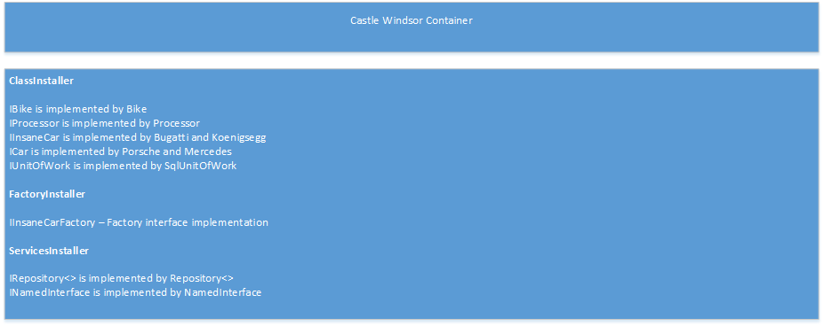
What is inversion of control?
Inversion of control is the passing of the responsibility of creating dependencies
to an external ‘container’. This ‘container’ is used to register all our types or dependencies.

Slide 3
Why bother with this? Why can’t I just new up objects?
Inversion of control, or the mechanism to achieve this (dependency injection) promotes loose coupling between objects. This leads to better application design.
Previously to test a feature in an application, the developer would have had to almost recreate the conditions and data for the test to be valid. In modern application programming parlance, this is referred to as an integration test.
Using Castle Windsor (or for that matter any other container like Unity, Autofac, Structure Map etc.), we can easily isolate key pieces of functionality so that they adhere to SOLID principles and are easily testable as well as making the software more robust by encouraging better application design.
The final advantage of using an IOC (inversion of control) container is to control the lifetime and disposal of objects.

Slide 4
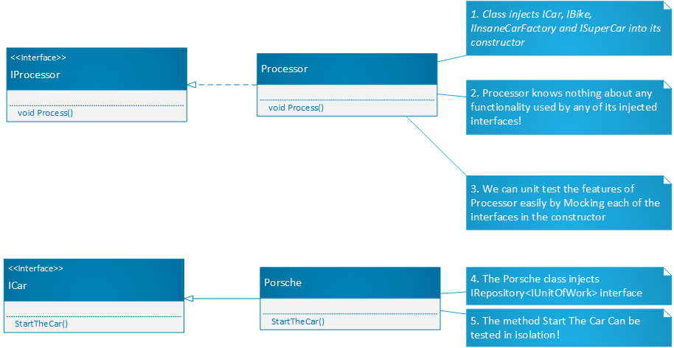
An architectural idea
Notes:
Notes for this slide:
Show them how to get the container via NUGET using either the context menu or the package manager.
Show them how to create the container in code
Illustrate that the best practice is to create a class which implements IWindsorInstaller, and instantiate that from either a bootstrapper class or in this case the program.cs

Slide 5
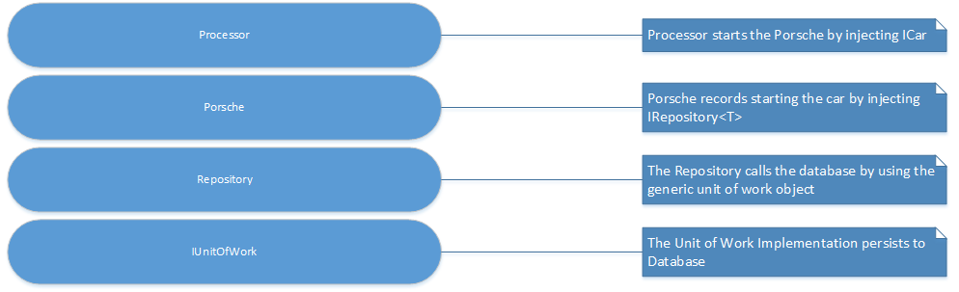
The dependency tree (from Processor)
Notes:
In order to comply with good application design as demonstrated by SOLID principles, we always register a component with its interface.
Show that when we register types in the container debugger we can see that the service and implementation is there in the collection.
Show them the console output of all the components.
Show them the code they can write to prove this.
private static void WriteAllContainerObjects(WindsorContainer container)
{
foreach (var handler in container.Kernel.GetAssignableHandlers(typeof(object)))
{
Console.WriteLine("{0} {1}",
handler.ComponentModel.Name,
handler.ComponentModel.Implementation);
Console.WriteLine();
}
}

Slide 6
Ways to register components
Configuration Based
<?xml version="1.0" encoding="utf-8" ?>
<configuration>
<components>
<component id="Mercedes"
service="Castle_Windsor_Demo.Interfaces.ICar, Castle_Windsor_Demo"
type="Castle_Windsor_Demo.Implementation.Mercedes, Castle_Windsor_Demo" />
<component id = "Porsche"
service="Castle_Windsor_Demo.Interfaces.ICar, Castle_Windsor_Demo"
type="Castle_Windsor_Demo.Implementation.Porsche, Castle_Windsor_Demo" />
</components>
</configuration>
container.Install(Configuration.FromXmlFile(@"Configuration.xml"));
Notes:
Take a look at all the installer classes for a demonstration of how this is done.
ClassesInstaller.cs
ServicesInstaller.cs
FactoryInstaller.cs

Slide 7
Ways to register components
Normal Class and Interface Registration by Fluent API
container.Register(Component.For<ICar>().ImplementedBy<Porsche>());
container.Register(Component.For<ICar>().ImplementedBy<Mercedes>());
Notes:
Take a look at all the installer classes for a demonstration of how this is done.
ClassesInstaller.cs
ServicesInstaller.cs
FactoryInstaller.cs

Slide 8
Ways to register components
OnCreate (Useful if something needs to exist before a feature is specifically implemented) (Demo)
container.Register(Component.For<ISuperCar>().ImplementedBy<Ferrari>()
.OnCreate((kernel, instance) => instance.TellTheCarToStart()));
Notes:
Take a look at all the installer classes for a demonstration of how this is done.
ClassesInstaller.cs
ServicesInstaller.cs
FactoryInstaller.cs

Slide 9
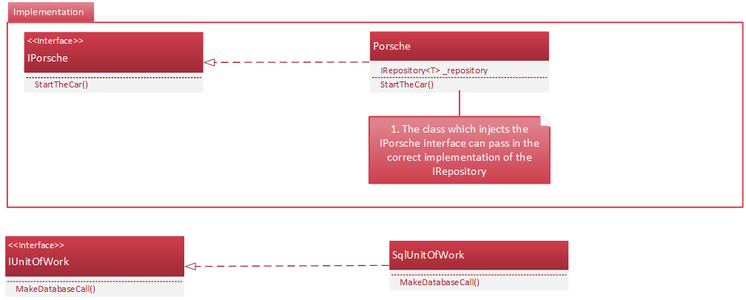
Ways to register components
Registering Generic Types – Demo: Show how to register a generic type
container.Register(Component.For(typeof(IRepository<>)).ImplementedBy(typeof(SqlRepository<>)).LifeStyle.Transient);
This is a simplified example of how to implement a couple of design patterns in Castle Windsor (Repository and Unit of Work)
(Demo)
Notes:
Take a look at all the installer classes for a demonstration of how this is done.
ClassesInstaller.cs
ServicesInstaller.cs
FactoryInstaller.cs

Slide 10
Component Resolution
To obtain the component dependency in a class we must call Resolve on the interface or inject the interface (via the constructor) into the class which wishes to use it. This concept of injection is what the inversion of control idea is built on.
When we resolve a dependency, all of the child objects that have dependencies are also resolved. (So long as the components are registered in the correct order – or we have registered all interfaces from an assembly!)
private readonly INamedInterface _namedInterface;
private readonly ILogService _logService;
public Ducati(INamedInterface namedInterface, ILogService logService)
{
_namedInterface = namedInterface;
_logService = logService;
}
var processor = container.Resolve<IProcessor>();
Notes:
Explain that so long as types are registered, including their interfaces as parameters in the constructor will act the same as calling Resolve<T> on the type.
Remove one of the registrations so that we can see the application throw an error when it cannot find one of the types to resolve.
Remove Ibike registration.
Show them the exception.

Slide 11
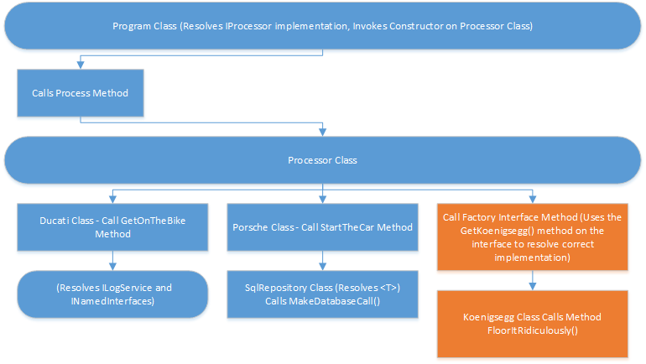
The Resolution Chain
Notes:
Explain that if two interface implementations are registered, the first one or the one which has IsDefault() specified is the one which will be resolved.
Create the two interfaces and add the IsDefault() configuration to one of them. So for the two Icar interfaces show that the Porsche one will always resolve unless IsDefault is specified on the Mercedes.
Add this.
container.Register(Component.For<ICar>().ImplementedBy<Mercedes>()).IsDefault()

Slide 12
Inline dependencies
Most IOC containers also provide support for inline dependencies.
Lets say that there is a property we have to set on a class before setting it up
A prime candidate for that might be log4net. i.e we want to tell it where to log the file when we create the dependency
(Demo)
const string logDirectory = @"some directory";
container.Register(Component.For<ILogService>().ImplementedBy<LogService>()
.DependsOn(Dependency.OnValue("LogDirectory",logDirectory)));
Notes:
Show them that the Inline dependency has been set
const string logDirectory = @"some directory";
container.Register(
Component.For<ILogService>().ImplementedBy<LogService>()
.DependsOn(Dependency.OnValue("LogDirectory", logDirectory))
Show them the debugged code where this property is set.

Slide 13
Lots of other ways and features!
There are many other registration features(I recommend a glance at the Castle Windsor site to look at different ways to register dependencies, properties, factories etc. – (https://github.com/castleproject/Windsor/tree/master/docs)
Notes:
Illustrate the lines in the FactoryInstaller.cs which allow us to create typed factories. Illustrate that we will need to name each component.
Talk about how we only need to register an interface for the factory (no implementation is needed)
The named instance is then prefixed by Get…… and Windsor automatically resolves the correct one for us.
Show that if we change the method on the interface we get a Koenigsegg instead.
public interface IInsaneCarFactory
{
IInsaneCar GetBugatti();
IInsaneCar GetKoenigsegg();
}
In Processor.cs
// Show that we can get a specific car from the factory
var insaneCar = _insaneCarFactory.GetBugatti();
insaneCar.FloorItRidiculously();

Slide 14
SOLID application design
We have just adhered to four facets of SOLID application design (cit. Bob C Martin) without really creating any patterns as such!
Single Responsibility Principle (each class does one thing and one thing only)
Open/Closed Principle (open for extension, closed for modification) – we can provide abstractions using abstract classes or interfaces which must be implemented i.e new classes created with the same interface.
Liskov substitution principle (or design by contract) – all objects can be replaceable with their subtypes without altering the correctness of the program.
Interface segregation – (well all of our classes are tied to interfaces!)
Dependency Inversion – (Any IOC container provides this)
Demo: Show how we have adhered to the four ticked facets
Notes:
Show how each type always has an interface
Illustrate that we have injected (inversion of control on the types)
Each class only does one thing and one thing only
Open closed principle based on interfaces i.e if you want to extend, add another method to the interface so it doesn’t break existing features.

Slide 15
Inversion of Control – Testing Software
Using an IOC container such as Castle Windsor allows a developer to test the software in isolation. So each dependency can be tested on its own.
The advantages of this are that bugs (so long as they are covered by tests) are picked up early, the existing features are a lot more difficult to break and there are existing patterns for testing extended features in the future.
Demo: Show and tell on simple unit testing in isolation.
Demo: Adding features to the app and breaking and fixing the tests.
Notes:
Show the test project and explain you need Nunit, MOQ or Rhino Mocks and TestDriven.NET or Resharper to run the tests.
Add extra code to break the tests and run all tests again and then fix the tests too.

Slide 16
Questions/Comments
The slides and the example code can be found in this location
https://github/jscanlon77/dependency-injection
And the Sonar Importer with the IOC container implemented with (291 tests around the functionality can be found here)
https://wts-svn.wellsfargo.com/wcrdr-fiit-sonar/branches/SONAR_IMPORT_IOC_BRANCH/
If folks are interested I can do a presentation on TDD including Mocking Libraries and NUnit)

